Slide 1
Lecture 6: gender and the division of labor part 2
SC22o5: Sociology of the family

Slide 2
Announcement
We aim to return your research paper outline in the week of 5 October
In the meantime, write the first draft

Slide 3
Where we have been…
Introduction to sociology of the family
Family as a social construct
Normal family ideology
Conceptual frameworks in the analysis of the family

Slide 4
Where we are going…
Family Formation, Transitions, and Dissolution
Romantic love and courtship
Marriage and cohabitation
Gender and the division of labor part 1
Sex and gender
Doing gender
Gender and power in families
Gender and the division of labor part 2 (Today)
Parenthood
Divorce

Slide 5
In this lecture…
Gender and the Division of Labor Part 2
Two Worlds? Work and Family
Family Friendly Workplaces
The Domestic Division of Labor

Slide 6
Two Worlds? Work and Family
Notes:
Experiences of both man and women, how there is a division of work.
Both man and women in the current society is expected to contribute to the financial and household work

Slide 7
Agricultural society
Husbands
Plowing
Planting
Harvesting
Educating older children
Wives
Preparation of food, cloth, candles, soap
Supervised farm animals and kitchen garden
Educating younger children

Slide 8
Industrial society
Husbands
Relieved from domestic duties
Engaged in “work”
“Primary breadwinner” and “good provider”
Wives
Relieved from supervision of family business
Consigned to domestic responsibilities
Devaluation of women’s work
Notes:
Start to earn money in exchange for their labour
Work became a paid activity, and in a workplace away from the home
Devalued as she is not paid

Slide 9
The ideology of separate spheres
Ideology of separate spheres
The widespread belief that women’s place should be in the home (the private sphere) and men’s should be in the work world outside the home (the public sphere)
Men were assumed to be naturally strict, aggressive, calculating, rational, and bold
Women were assumed to be naturally nurturing, demure, and sacrificial
Notes:
Limited job opportunities for women due to this belief

Slide 10
Discounting women’s work in industrial society
Poor and working class women
Low paid, unskilled jobs in factories
Black women
Domestic work
Middle- and upper-class white women
Nursing and teaching
Notes:
Experiences of industrialization were different for different groups of women.
Poor and working class women were often exploited
Black women- stay in homes of middle and upper class white people to serve them

Slide 11

Discounting women’s work in industrial society
The ideology of separate spheres waxed and waned with wider economic and political needs
During World War II, the government initiated a campaign to persuade women out of their homes and into factories
Childcare centres depicted as nurturing environments
After the war ended, working women were labeled as selfish and irresponsible
Childcare centres depicted as horrible, dangerous places
Notes:
Needed women to replace men at factories

Slide 12
Gender in the workplace: discrimination built into the system
Imagine you are a boss, what do you consider a good worker?

Slide 13
Gender in the workplace: discrimination built into the system
Imagine you are a boss and you have just been told that your best employee, Chris, is engaged to be married…
Man
Woman
His upcoming marriage as a “stabilizing” influence
Job security extremely important, making him a more dependable worker
Need a raise because of impending fatherhood
Motivated to work harder and longer to support his family
Her upcoming marriage as potential impediment to career mobility
Will she move if her husband finds a good job somewhere else?
How long will it be before she becomes pregnant and seeks maternity leave or quits?
Marriage makes her seem less dependable, less stable, and less committed to the job

Slide 14
Gender in the workplace: the wage gap
Wage gap
A persistent difference in the amount of money women earn compared to men, regardless of occupation
Women worldwide average 78% of the wages given to men for the same work
Compared to women without children, mothers looking for work are offered lower starting salaries
Charting the work experiences of more than 5,000 women over a 10-year period, mothers’ wages dropped by 7% per child
Among mothers who graduated from university in 1993, more than one third were either out of the labor force entirely or had switched to part-time work 10 years later
Over the span of her working life, a university-educated woman can lose up to $1 million in wages given up in the interests of caring for others
Notes:
Men are assumed to be not the primary parent, and research indicated men who gets married get higher wages than men who are still single

Slide 15
Gender in the workplace: the wage gap
Why does the wage gap persist?
Occupational segregation and the types of jobs women are most likely to have
Workplace discrimination keeps women from reaching the upper echelons of their professions
More employed women work part time than employed men
Part-time workers earn less
During economic recessions, they are the first ones pushed out of employment not because they are women but because their jobs are the most expendable
Notes:
Men have more time, and can be able to keep to full schedules.

Slide 16
Family friendly workplaces

Slide 17
Family leave policies in Singapore
Government-paid maternity leave
Working mothers are entitled to 16 weeks of leave at the birth of their child
Government-paid shared parental leave
Working fathers are entitled to 1 week of their wives’ paid-maternity leave
Government-paid paternity leave
Working fathers are entitled to 1 week of leave
Employers can voluntarily grant up to 1 additional week of leave to fathers
Government-paid maternity benefit
This scheme benefits shorter-term workers who have been in employment for at least 90 days in the 12 months immediately before the birth of their child

Slide 18
Family leave policies in Singapore
Government-paid child care leave
If the youngest child is under the age of 7 years, working parents are each entitled to 6 days of paid childcare leave over a 12-month period
If the youngest child is between the age of 7 and 12 years, working parents are each entitled to 2 days of paid childcare leave over a 12-month period
Unpaid infant care leave
Working parents are entitled to 6 days of unpaid infant care leave a year
Notes:
Singapore still lacks behind other post industrial countries

Slide 19
Family leave policies around the world
Bulgaria
Mothers receive 45 days of sick leave at 100% pay prior to the date their child is due to be born
After the child is born, they are entitled to 2 years of paid leave and 1 additional year of unpaid leave
The employer is required to restore the mother to the same position upon return to work
Pregnant women and single mothers cannot be fired
France
Mothers receive 16 weeks off work at 84% pay for the first and second children, and 24 weeks off at the same rate of pay for the third and subsequent children
They also received up to 3 years of unpaid leave with job protection

Slide 20
Family leave policies around the world
Norway
Parents can take 42 weeks of leave at 100% pay or 52 weeks at 80%
Fathers are entitled to 4 weeks of this leave
Parents can also combine part-time work and partial parental benefits
For example, one parent could take full leave at 100% pay for 42 weeks and the other could combine 80% work and 20% leave for nearly 2 years
United Kingdom
Parents receive 18 weeks of maternity leave at 90% of their salary and 12 weeks at a flat rate
They can also take up to 40 weeks of unpaid family leave

Slide 21
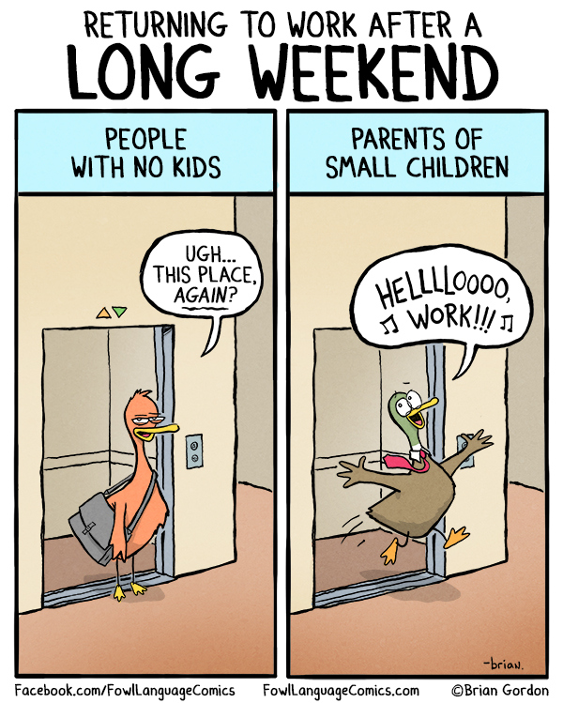
Family friendly workplaces
In her study of a Fortune 500 public relations company, Arlie Hochschild (2003) uncovered a different reason behind some individuals’ reluctance to work less and spend more time with family
Home had become a world of unrelenting demands, unresolved quarrels, and unwashed laundry
Work had become a world of relative harmony, companionship, and understanding
Notes:
Work has become the relaxed component instead of home

Slide 22
Family friendly workplaces
Single and childless workers are beginning to speak out against family friendly policies
They feel that workers with few family obligations are footing the bill for these policies
Compared to other employees, single, childless workers say they work longer hours, receive fewer benefits, and have less flexible vacation time

Slide 23
The domestic division of labor

Slide 24
Domestic work
The invisibility of domestic work stems from two important sources
Domestic work is a “labor of love” and not work at all
Domestic work is unpaid

Slide 25
Domestic work
Feeding work
Planning meals
Learning about foods
Housework
Cleaning house
Kin work
Visiting relatives
Visiting stores
Buying food
Preparing the meals
Cleaning after meals
Caring for clothing and linen
Caring for pets and plants
Managing household paperwork and financial work
Scheduling and monitoring home repairs and maintenance
Consumption work
Making telephone calls
Purchasing gifts
Reading about products and services
Comparison shopping
Monitoring performance of products and services
Organizing manuals and instructions
Notes:
A lot of “work”

Slide 26
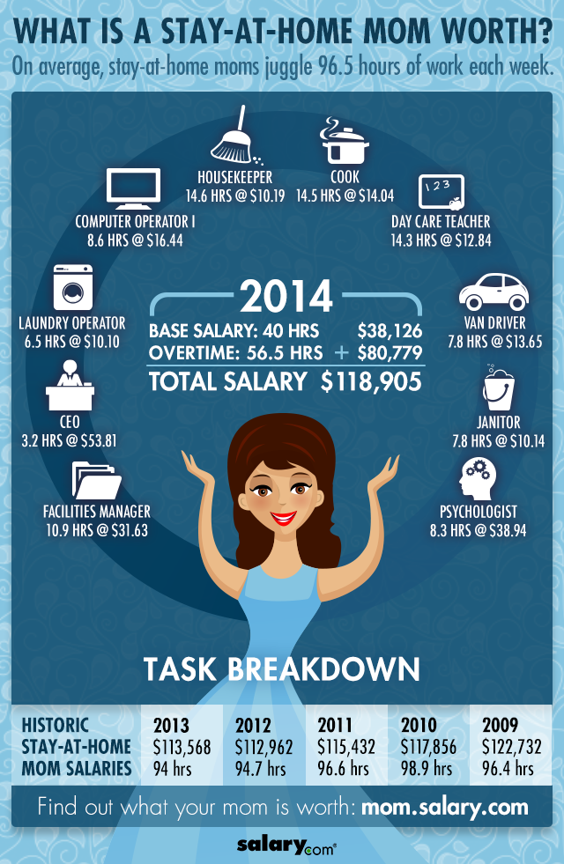
Domestic work
Notes:
Outside the main economy thus work is not considered work

Slide 27
The “second shift”
Because of persistent gender disparity in household and childcare responsibilities, Arlie Hochschild and Anne Machung (1989) point out that the average working wife routinely works two shifts – one at the office and one at home
The domestic work men tends to do is different from the work women do (Lee and Waite 2005)
When women earn more than men, couples may resort to a traditional division of labor in order to reinforce gender differences that could be undermined by the interchanging of traditional economic roles (Arrighi and Maume 2000)
Having children often means more work inside the house for women and more work outside the house for men (Cowan and Cowan 2000)
Notes:
Arlie Hochschild and Anne Machung (1989) The Second Shift. New York: Viking Penguin. Inc
Yun-Suk Lee and Linda J. Waite (2005) “Husbands’ and Wives’ Time Spent on Housework: A Comparison of Measures.” Journal of Marriage and Family, 67(2): 328-36.
Barbara A. Arrighi and David J. Maume (2000) “Workplace Subordination and Men’s Avoidance of Housework.” Journal of Family Issues, 21(4): 464-87.
Carolyn Pape Cowan and Philip A. Cowan (2000) When Partners Become Parents. New York and London: Routledge.

Slide 28
“Women’s work”, “men’s help”
Many men define domestic work as “help” (Hochschild and Machung 1989)
For example, some fathers tend to refer to their responsibility for childcare as “babysitting”
A key social element of “help” is that it obligates the individual receiving assistance to express gratitude
Defining unpaid household labor and childrearing as “women’s work” upholds male privilege in society
Are we experiencing as a “stalled revolution”?

Slide 29
Summary
The contemporary belief that family life and work life are separate spheres emerged with industrialization in the 19th century
Women’s experiences in the labor force – from the jobs they occupy to the wages they earn – are still tied to the ideology of separate spheres
The dramatic increase in dual-earner families has placed unprecedented demands on the workplace to accommodate employees with family obligations
The growing presence of women in the labor force has not been accompanied by a significant increase in the responsibility men take for domestic work

